Slide 1

Guide for IEEE Authors in Greece
Navigating the open access publication process from submission to acceptance to OA funding

Slide 2
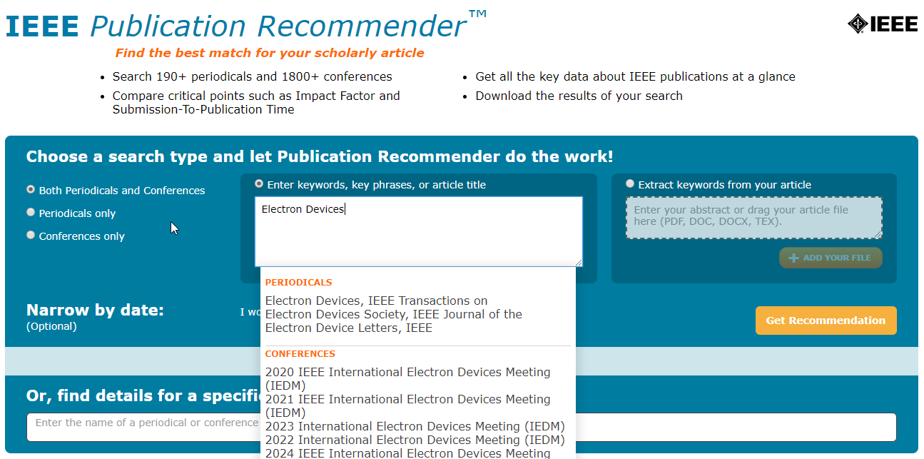
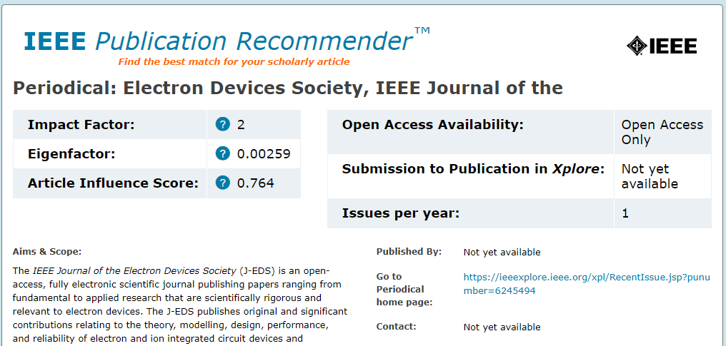
Choosing Where to Submit
https://publication-recommender.ieee.org/home
IEEE Publication Recommender helps authors find the most suitable journal and displays journal’s OA Status with submission URL
Note: Open Access status clearly displayed in results.

Slide 3
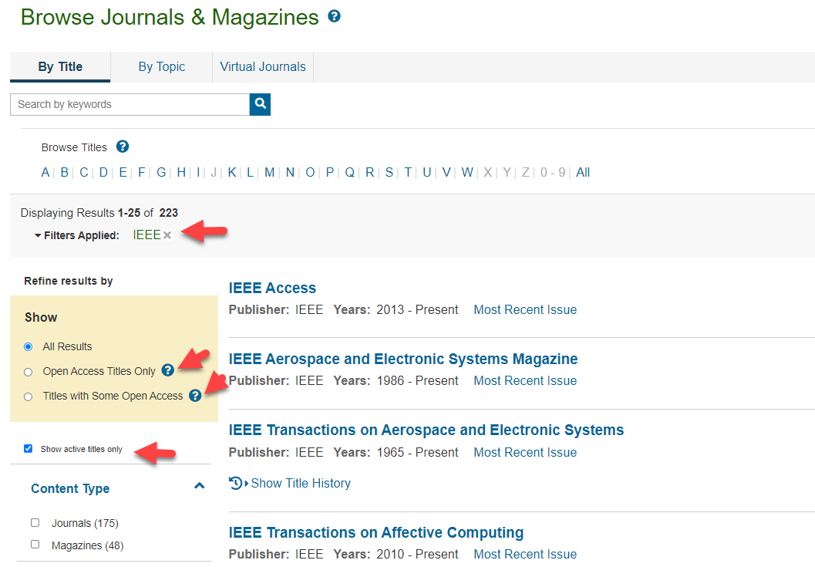
Choosing Where to Submit – in IEEE Xplore
https://ieeexplore.ieee.org/browse/periodicals/title?refinements=Publisher:IEEE&showActiveTitlesOnly=true

Slide 4
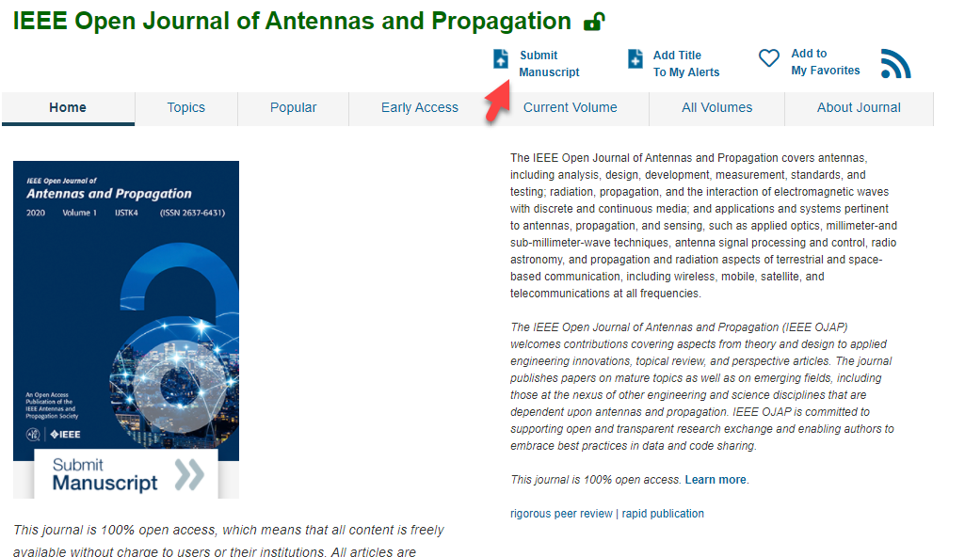

Slide 5
Submission Process – OA vs. Hybrid
The corresponding author completes the submission process,
OA Only journals only publish open access articles. Authors submitting to OA-only journals must confirm their agreement to the OA charges during the first step of the submission process.
Hybrid OA journals allow authors the option to choose whether they would like their article to be OA or not. Authors submitting to hybrid journals will be asked to make their OA choice after acceptance, during the submission of final materials.

Slide 6
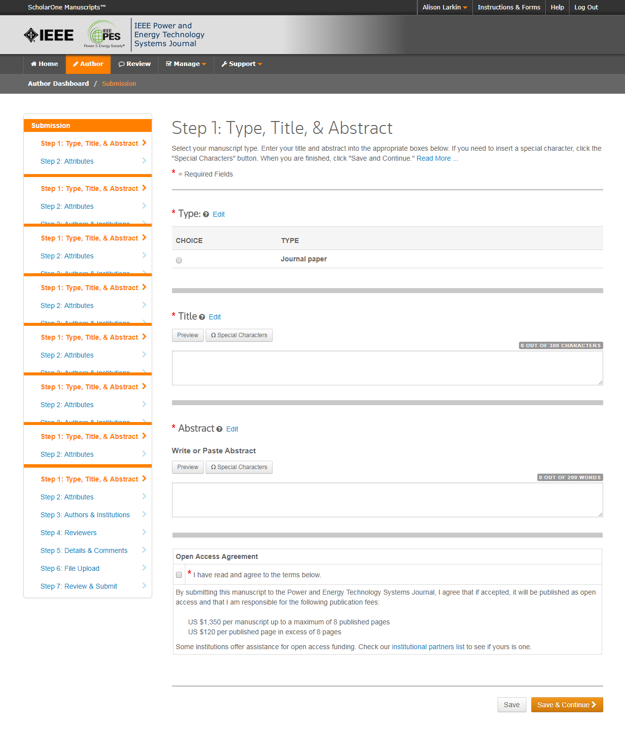
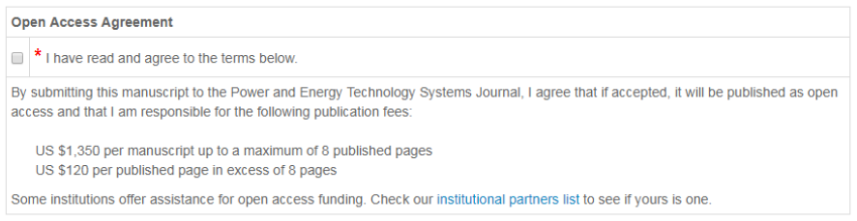
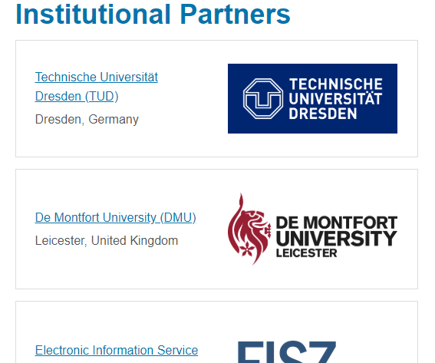
Step 1 of Submission to an OA Only Journal
Open Access agreement is present.
Note: Overlength page charges are set at the society’s discretion, and differ from journal to journal. Not all journals charge page charges.

Slide 7
Submission process – Step 2
General requirements may vary journal to journal, but there are several key elements that are important to complete at this time to ensure proper Open Access processing later during publication
  Assigning Authors
  Identifying Institution

Slide 8
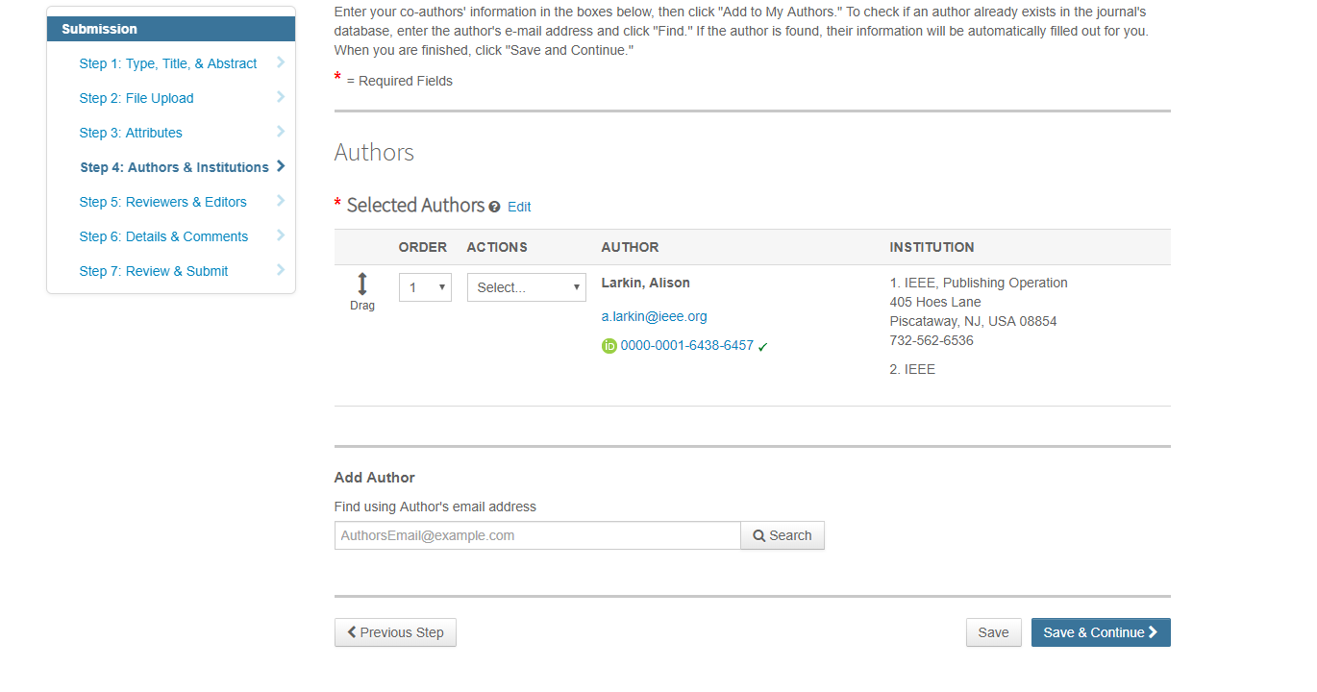
Adding Authors During Submission
The submitting author enters all co-author information.
If the co-author does not have an account, the submitting author will create one, and add institution data.
The submitting author’s institution data will be used to match the author with their institutional OA account.
Note: Some institutions will not fund publication if their institution is not listed first.
PLEASE USE your INSTITUTIONAL EMAIL ADDRESS!

Slide 9
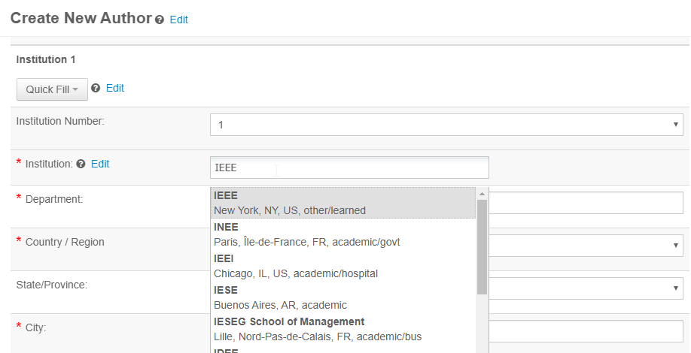
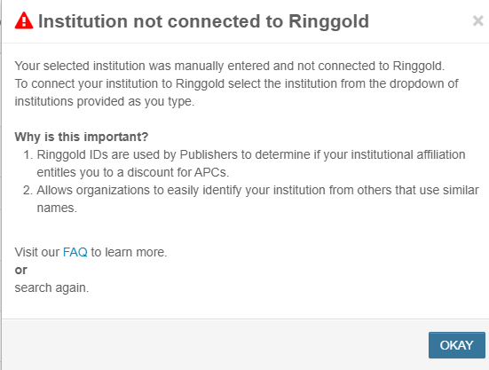
Connecting Ringgold During Submission
Ringgold IDs are integrated in the submission system.
When adding an author’s institution information, the system will present the author with a list of institutions that most closely match what the author has entered.
If the author does not tie the affiliation to a Ringgold, a warning message appears.
PLEASE SELECT THE INSTITUTION NAME FROM THE DROPDOWN

Slide 10
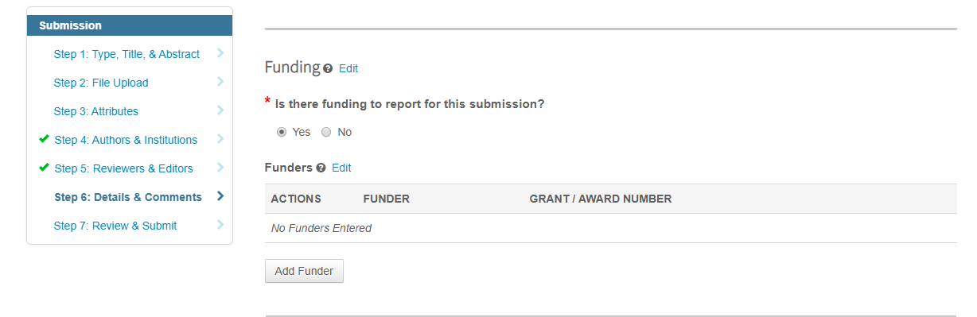
Entering Funding Information at Submission
The submitting author will be required to disclose any funding information during submission.

Slide 11
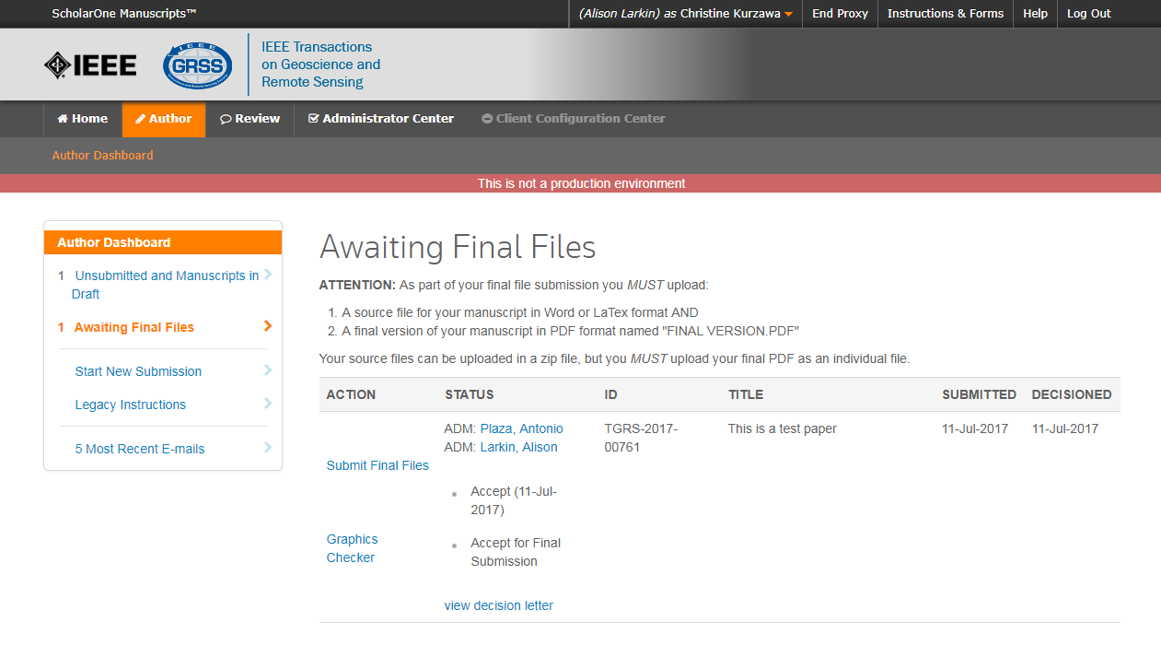
Acceptance
If the manuscript is accepted, the author will be prompted to upload the final files and choose a copyright license.
After acceptance, hybrid journal authors may choose whether to publish open access.

Slide 12
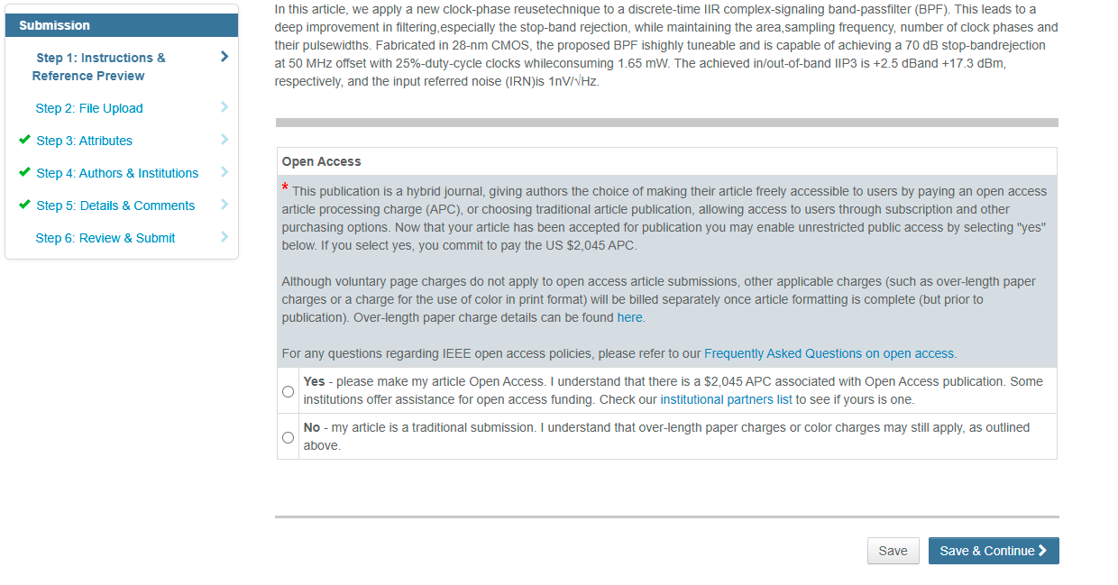
Post acceptance – hybrid review
Note: Author of papers published in hybrid journals are only asked about open access after acceptance.

Slide 13
Post acceptance – copyright selection
After acceptance, authors will be prompted to choose their copyright license using the Electronic Copyright Form (eCF).
Authors publishing in open access articles may choose between CCBY or CCBY NC-ND.
  - A CC BY 4.0 license (in which the author retains copyright and the article is published open access).
  - A CC BY NC-ND license (a more restrictive license than CCBY in that the article may not be reused for commercial purposes, nor may the article be changed in any way.)
Authors should confirm any license restrictions set by the institution.
CC BY 4.0 is preferred

Slide 14
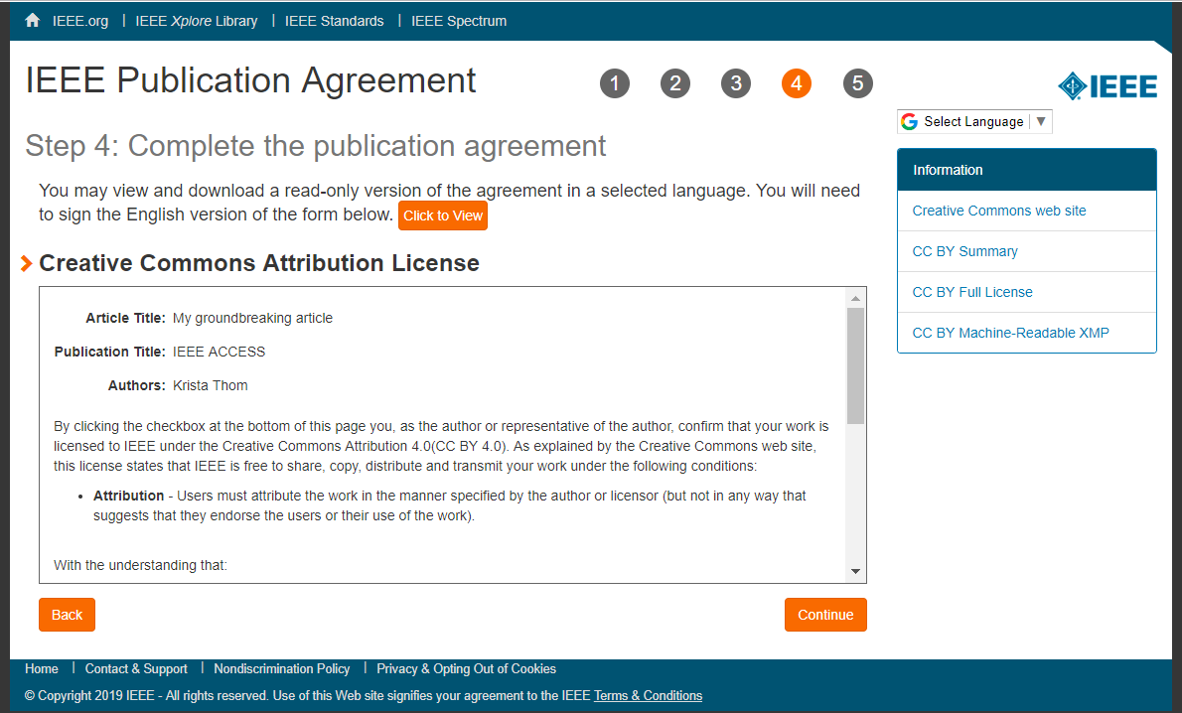
eCF – step 3
Authors of open access articles are prompted to select the CCBY license type.

Slide 15
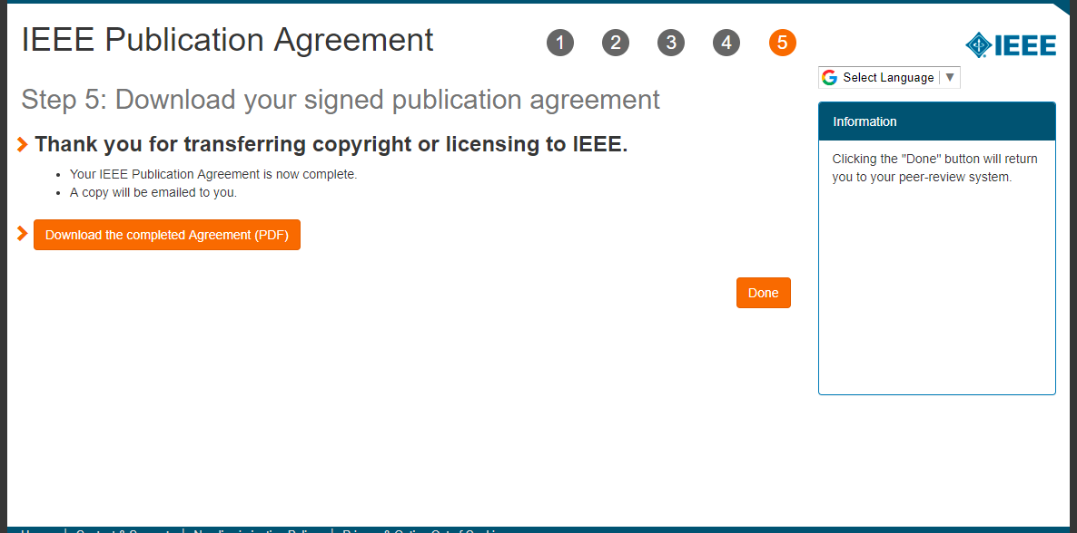
eCF – step 5
After the author has submitted an electronic signature, they will be able to download a copy of the license agreement.

Slide 16
RightsLink for Scientific Communications (RLSC)
All article processing charges (APCs) are handled through RLSC.
After acceptance, RLSC will generate a funding request for the administrator at HEAL-Link if the corresponding author is affiliated with one of the member institutions of HEAL-Link.
  Institutional profiles are matched using author-provided affiliation data including institution email domains and/or Ringgold IDs.
  In some cases, the author’s email domain may also be used as a matching criterion.
Authors will not need to request OA funding through RLSC as this is done when a match is made between their manuscript metadata and the institution’s profile in RLSC.
Only Open access charges are covered in this agreement (overlength page charges and color charges are covered by the authors)

Slide 17
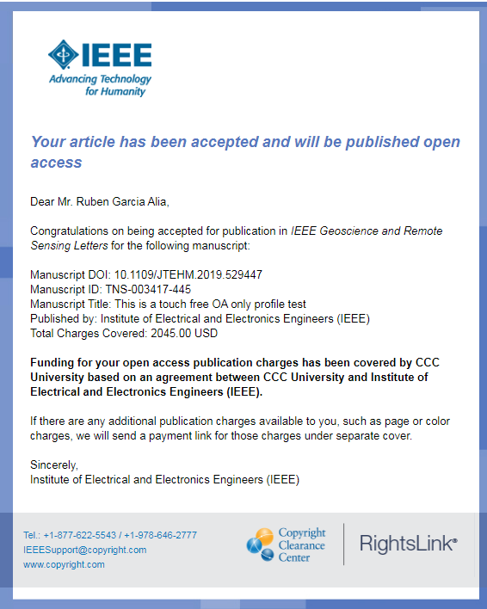
Approving requests
The author receives an email when the request is approved
or denied by the admin at HEAL-Link.

Slide 18
Need additional assistance?
IEEE Open Site
  https://open.ieee.org/
IEEE Author Center
  https://ieeeauthorcenter.ieee.org/
IEEE Xplore Digital Library
  https://ieeexplore.ieee.org/
IEEE Publications Recommender
  https://publication-recommender.ieee.org/
Scholarly Communication Unit, HEAL-Link
  https://scholarly.heal-link.gr/guide/#ieee
HEAL-Link Open Access Agreements
  https://www.heal-link.gr/en/open-access-agreements/
Please email onlinesupport@ieee.org with any questions on the agreement or articles

